Slide 1

EditEdit MasterMaster texttext stylesstyles
Lecture 1: Concepts & Basics of C++ Programming

Slide 2

Today’s Agenda
Today we are going to cover -
Basics of ‘C’- Recap
Loops in ‘C’ -Recap
Your Knowledge check

Slide 3
MCQ Questions
Let’s Get Started-

Slide 4
Problem - 1
Q. Spreadsheet or Excel is which kind of software?
OS
System software
Application software
None of the above

Slide 5
solution- 1
Q. Spreadsheet or Excel is which kind of software?
OS
System software
Application software
None of the above

Slide 6
Hint : Layered view of computer
Application Programs Word-Processors, Spreadsheets, Database Software, IDEs, etc…
System Software Compilers, Interpreters,Preprocessors, etc Operating System, Device Drivers
Machine with all its hardware

Slide 7
Problem - 2
Which of the following is machine dependent and non- portable languages?
Assembly language
Machine language
High level language
1 & 3
2 & 3
1 & 2
All

Slide 8
solution- 2
Which of the following is machine dependent and non- portable languages?
Assembly language
Machine language
High level language
1 & 3
2 & 3
1 & 2
All

Slide 9
Hint: Solution
Machine Language
Uses binary code
Machine-dependent
Not portable
Assembly Language
Uses mnemonics
Machine-dependent
Not usually portable
High-Level Language (HLL)
Uses English-like language
Machine independent
Portable (but must be compiled for different platforms)
Examples: Pascal, C, C++, Java, Fortran, . . .

Slide 10
Source code/object code/ executable file
Source program
The form in which a computer program, written in some formal programming language, is written by the programmer.
Object program
Output from the compiler (Files with extension ‘.obj’)
Equivalent machine language translation of the source program into object code or machine code
Executable program
Output from linker/loader (Files with extension ‘.exe’)
Machine language program linked with necessary libraries & other files

Slide 11
Linker
A program that pulls other programs together so that they can run.
Most programs are very large and consist of several modules.
Even small programs use existing code provided by the programming environment called libraries.
The linker pulls everything together, makes sure that references to other parts of the program (code) are resolved.

Slide 12
How program runs?
Memory
Machine language program (executable file)
C P U
Input Data
Data entered during execution
Computed results
Program Output

Slide 13
Problem - 4
What types of errors do you encounter while executing C program?
Syntax errors
Logical errors
Runtime errors
1
2
3
All

Slide 14
solution- 4
What types of errors do you encounter while executing C program?
Syntax errors
Logical errors
Runtime errors
1
2
3
All

Slide 15
Hint:Solution
Syntax Errors:
Errors in grammar of the language
Runtime error:
When there are no syntax errors, but the program can’t complete execution
Divide by zero
Invalid input data
Logical errors:
The program completes execution, but delivers incorrect results
Incorrect usage of parentheses

Slide 16
Problem - 5
Which one is better to use: Compiler or interpreter?
Compiler
Interpreter
Both
Depends on the requirement

Slide 17
solution- 5
Which one is better to use: Compiler or interpreter?
Compiler
Interpreter
Both
Depends on the requirement

Slide 18
Hint : solution
Compilation:
Syntax errors caught before running the program
Better performance
Decisions made once, at compile time
Interpretation:
Better diagnostics (error messages)
More flexibility
Supports late binding (delaying decisions about program implementation until runtime)
Can better cope with PLs where type and size of variables depend on input
Supports creation/modification of program code on the fly (e.g. Lisp, Prolog)

Slide 19
Problem - 6
Which of the following is basic data type?
Int
Char
double
Float
1,2
1,2,4
All
1,2,3

Slide 20
Solution- 6
Which of the following is basic data type?
Int
Char
double
Float
1,2
1,2,4
All
1,2,3

Slide 21
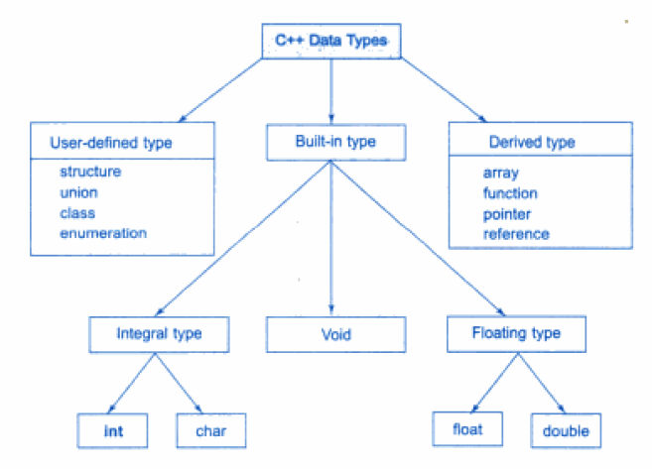
Solution

Slide 22
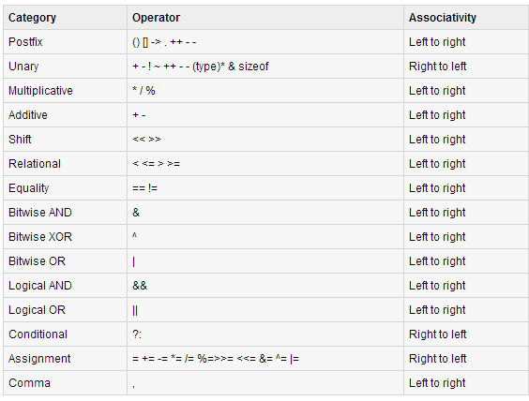
Operator precedence and associativity

Slide 23
Simple C++ program
C
/* my first program in C */
#include <stdio.h>
int main()
{
printf(“Welcome to C….\n");
return 0;
}
C++
/*my first program in C++*/
#include<iostream>
using namespace std;
int main()
{
cout<< “Welcome to C++…. \n”;
return 0;
}

Slide 24
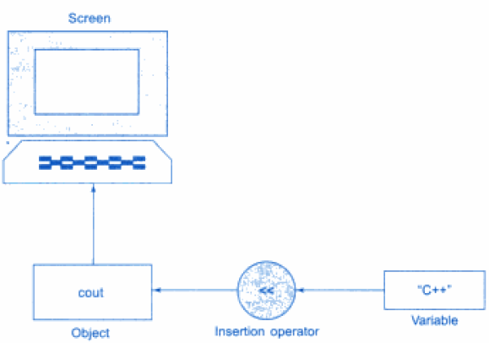
Output operator
The statement
cout<< “C++ is better than C. \n”;
The statement causes the string in quotation marks to be displayed on screen.

Slide 25
Question
How to display value of variable a in c++ like following?
Value of a = 5
Hint : In c , printf(“Value of a= %d” , a);

Slide 26
Solution
How to display value of variable a in c++ like following?
Value of a = 5
Hint : In c , printf(“Value of a= %d” , a);
cout<< “Value of a”<<a;

Slide 27
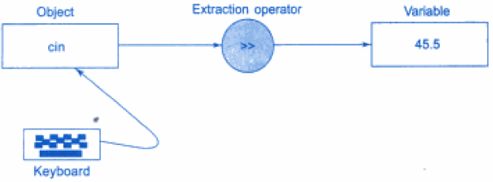
Input operator
The statement
cin>> number;
is an input statement and causes the program to wait for the user to type in a input.

Slide 28
Question
How to accept value of variables a,b from user in c++ like following?
Hint : In c , scanf(“%d%d” , &a, &b);

Slide 29
Solution
How to accept value of variables a,b from user in c++ like following?
Hint : In c , scanf(“%d%d” , &a, &b);
cin>>a>>b;

Slide 30
Control structures
One of the instructions, statements or groups of statements in a programming language which determines the sequence of execution of other instructions or statements is called control structure.
In C++ there are three Control Structures.
Sequence Structure (straight line)
Selection Structure (branching)
Loop Structure (iteration or repetition)

Slide 31
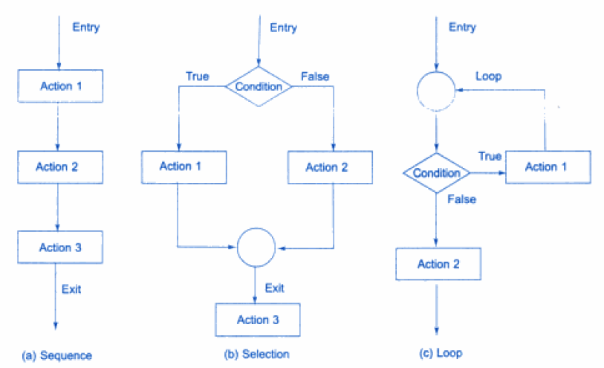
Control Structures

Slide 32
Problem
Which are the following are selection structures( branching)?
If
If else
Nested if
Switch
1,2
1,2,3
All
2,3,4

Slide 33
Solution
Which are the following are selection structures( branching)?
If
If else
Nested if
Switch
1,2
1,2,3
All
2,3,4

Slide 34
Selection Structure
C++ programming language provides following types of selection statements.
if statements
if .. else statements
Nested if statements
To do: Learn Syntax of each of these types
switch statements

Slide 35
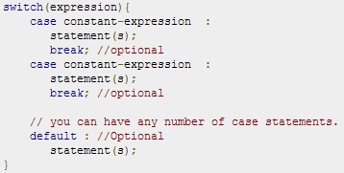
Selection Structure (Switch)
A switch statement allows a variable to be tested for equality against a list of values.
Each value is called a case, and the variable being switched on is checked for each case.
Syntax:

Slide 36
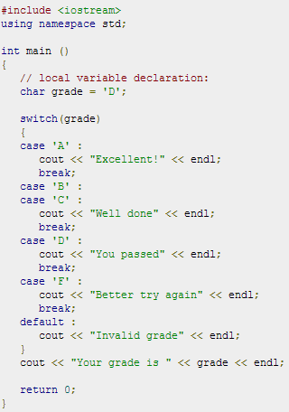
Problem

Slide 37
Problem
Which are the entry controlled loops in C?
For
while
Do..while
All
1 ,2
2,3
1,3

Slide 38
Solution
Which are the entry controlled loops in C?
For
while
Do..while
All
1 ,2
2,3
1,3

Slide 39
Solution
Which are the entry controlled loops in C?
For
while
Do..while
All
1 ,2
2,3
1,3

Slide 40
Program output?
#include <iostream>
using namespace std;
int main()
{
int a=10;
while(a>20)
{
cout<<"value of a: "<<a<<endl;
a++;
}
cout<<endl<<"end of program";
return 0;
}

Slide 41
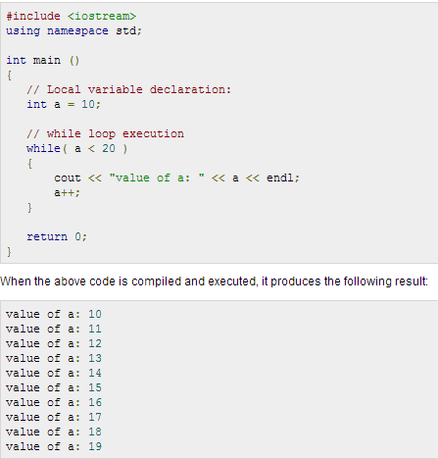
Program output

Slide 42
Program output?
#include <iostream>
using namespace std;
int main()
{
int a=10;
do
{
cout<<"value of a: "<<a<<endl;
a++;
}while(a>20);
cout<<endl<<"end of program";
return 0;
}

Slide 43
Program output

Slide 44
Program output?
#include <iostream>
using namespace std;
int main()
{
for( int a=10; a<20;a++)
{
cout<<"value of a: "<<a<<endl;
}
return 0;
}

Slide 45
Program output

Slide 46
Nested loops
#include <iostream>
using namespace std;
int main()
{
for( int a=1; a<5;a++)
{
for(int b=1;b<3;b++)
cout<<"value of a: "<<a<<" "<<b<<endl;
cout<<"value of b"<<b;
}
cout<<"value of b";
cout<<endl<<"end of program";
return 0;
}

Slide 47
Nested loops
Other kind of nesting is combination of the following
Do …while
For
while

Slide 48
Questions
What will be the value of y after second statement is executed?
a=5,b=3,m=6;
y=a*++b/2+m%2

Slide 49
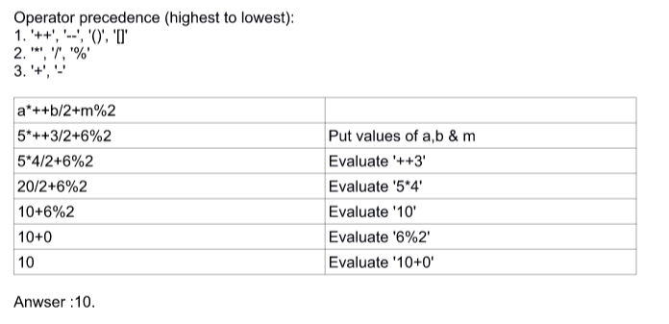
Solution:
What will be the value of y after second statement is executed?
a=5,b=3,m=6;
y=a*++b/2+m%2

Slide 50
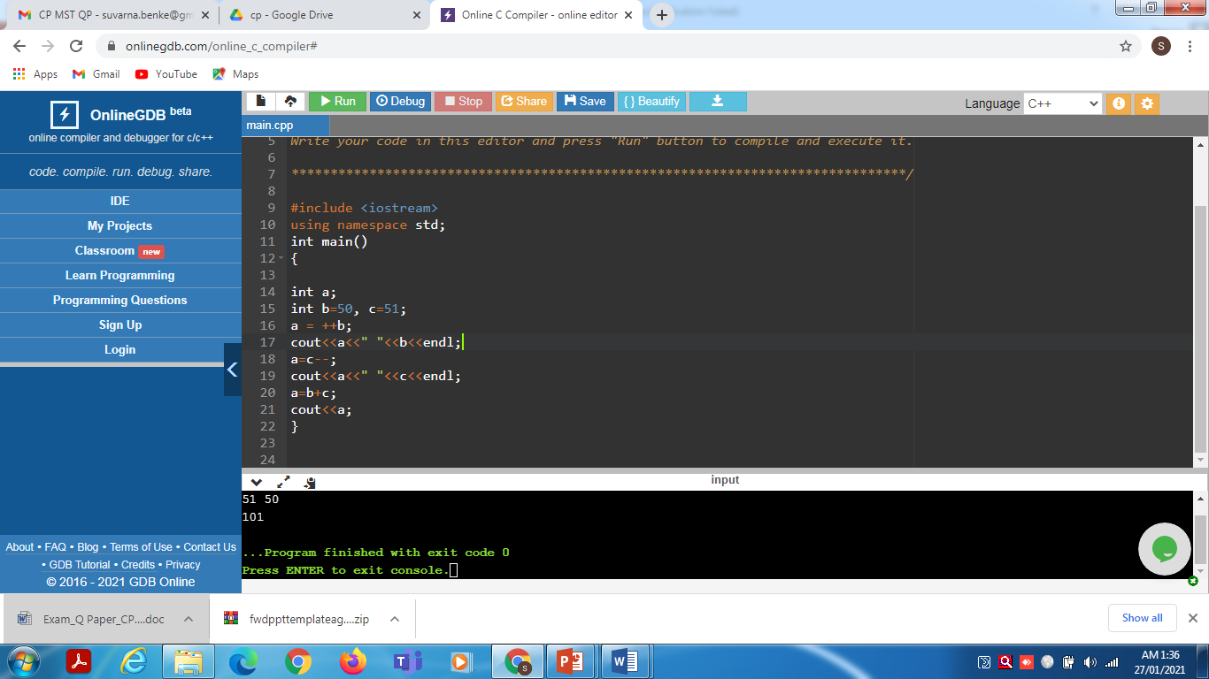
Predict the output!

Slide 51
Predict the output!
Output:
51 51
51 50
101

Slide 52
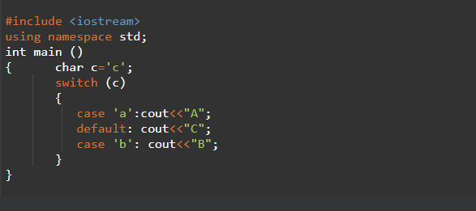
Predict the output!

Slide 53
Predict the output!
Output: CB

Slide 54
Predict the output!
#include <iostream>
using namespace std;
int main ()
{
int i=5;
while(i=5)
{
cout<<i<<endl;
i--;
}
}

Slide 55
Coding Questions Time
1.Write a program in C++ to swap two numbers without taking third variable.
Sample Output:
Swap two numbers :
Input 1st number : 25
Input 2nd number : 39
After swapping the 1st number is : 39
After swapping the 2nd number is : 25

Slide 56
Coding Questions Time – For students
1. Write a program in C++ to convert temperature in Celsius to Fahrenheit.
Sample Output:
Convert temperature in Celsius to Fahrenheit :
Input the temperature in Celsius : 35
The temperature in Celsius : 35
The temperature in Fahrenheit : 95

Slide 57
Coding Questions Time
Write a program to check whether given character is a vowel, integer or special character using if-else statement.
Input: Enter a character : e /E
Output: ‘E’ is a vowel
Input: Enter a character: 7
Output: 7 is a digit
Input:Enter a character: &
output: & is a special character

Slide 58
Coding Questions Time – For students
Write a C++ program to accept marks of 5 subjects for a student. Calculate the total and percentage of marks, also decide grade of student depending on the percentage using nested if-else statement. Consider grade range as per your assumption.
Input : Enter marks of student:
Sub1: 80
Sub2:90
Sub3:85
Sub4:90
Sub5: 85
Output: Total marks =430 out of 500
Percentage marks: 86.0
Grade obtained : A

Slide 59
Coding Questions Time
1.Write a program in C++ to for menu driven calculator using switch case Statement
Menu:
+ Addition
- Subtraction
* multiplication
/ Division
Enter operator : -
Enter two operands:
3.4
8.4
Output:
3.4 - 8.4 = -5.0

Slide 60
Coding Questions Time
Write a C++ program to calculate factorial of a number using do-while loop.
Input:-5
Output:-120
Write a C++ program to reverse a number using while loop.
Input:-3674
Output:-4763

Slide 61
Coding Questions Time
3.Write a program to print the sum of all numbers in a digit using for loop.
Input:-2981
Output:-20
For students:
Write a program to find first N natural numbers. Also display their sum and sum of their sqaures using for loop.
Input: Enter the value of N: 15
Output: Sum of first 15 natural numbers : 120
Sum of squares of these numbers: 1240

Slide 62

QNA Time
Any Questions??
Any Questions ??

Slide 63
Thank You!
See you guys in next class.

